Slide 1
DISCLAIMER
The content and opinions presented during conference AgileByExample 2024 are solely based on individual expertise of Joanna Kaczyńska and can not be associated with Ministry of Finance, Poland.
PHOTOS pexels.com

Slide 2
RISK MANAGEMENT CULTURE

Slide 6
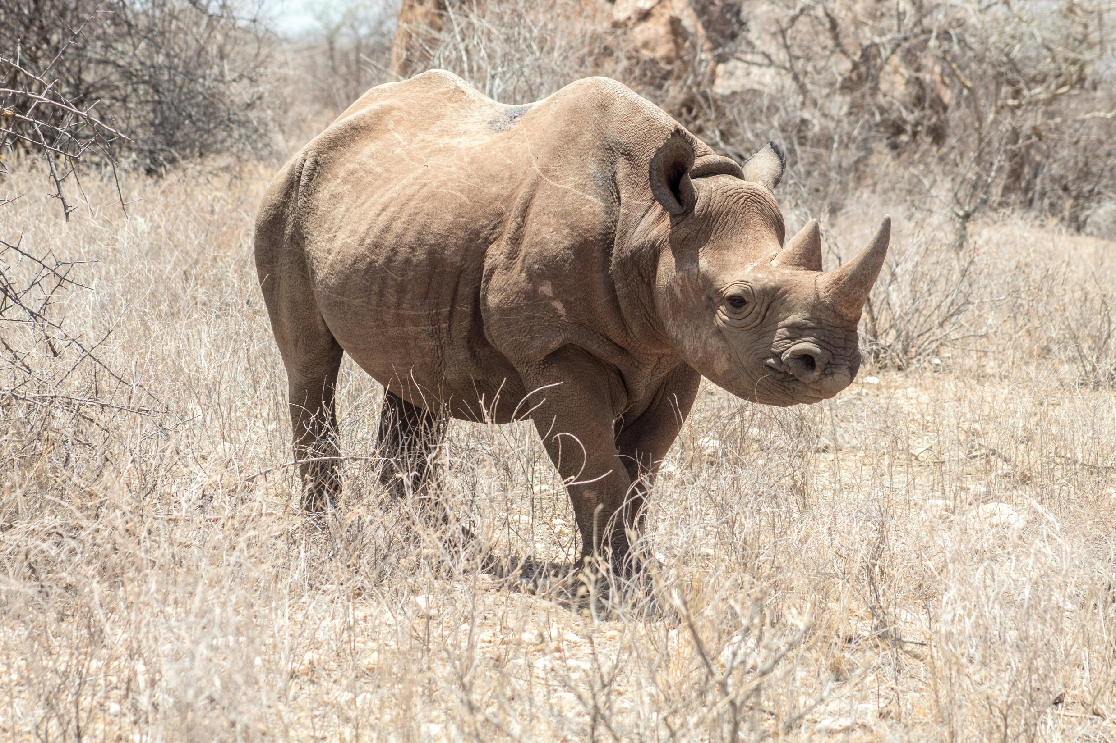

Slide 13
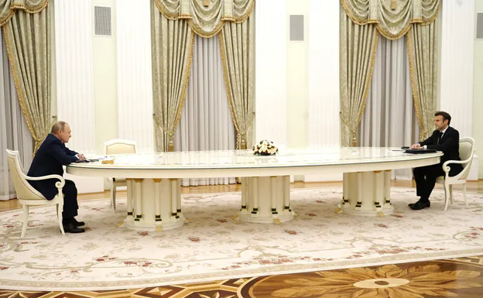
Wyborcza.pl (AP/AP)

Slide 14
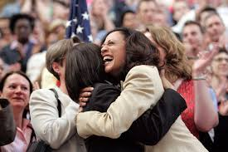
Google Public Images

Slide 20
IMAGINATION PRECISION
QUESTIONS ANSWERS
PEOPLE PROCEDURES

Slide 21
„CULTURE EATS STRATEGY FOR BREAKFAST” Peter Drucker

Slide 22
THE END
joanna.kaczynska@ekspertkirazem.pl
#ApetytNaRyzyko

